Slide 1
Closed Energy Budgets for Regional Numerical Simulations
Parker MacCready
University of Washington

Slide 2
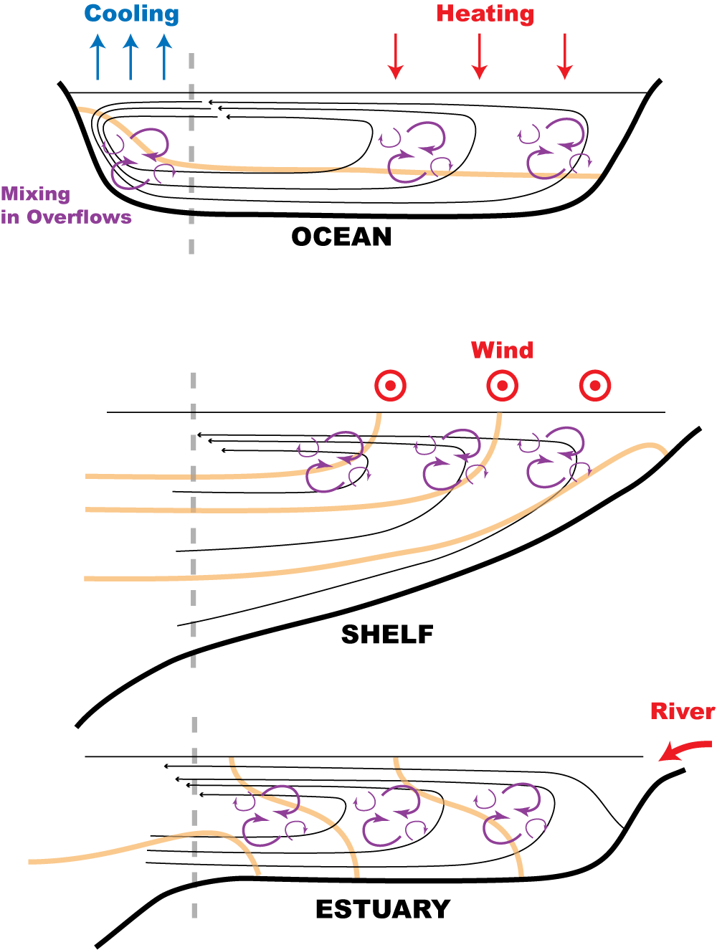
Stories
Coastal upwelling: the energy comes from wind stress and is drained by bottom friction
Estuaries: the energy comes from tidal mixing and is drained by the exchange flow

Slide 3
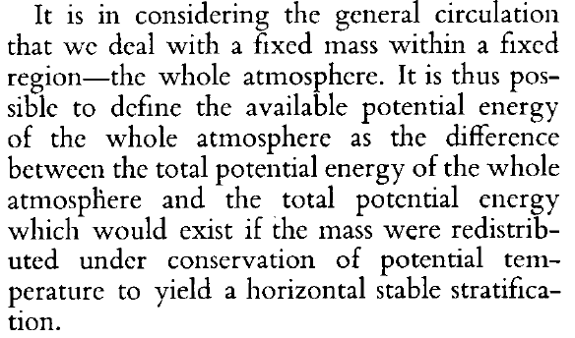
“Available potential energy and the maintenance of the general circulation” Edward N. Lorenz (1955) Tellus

Slide 4
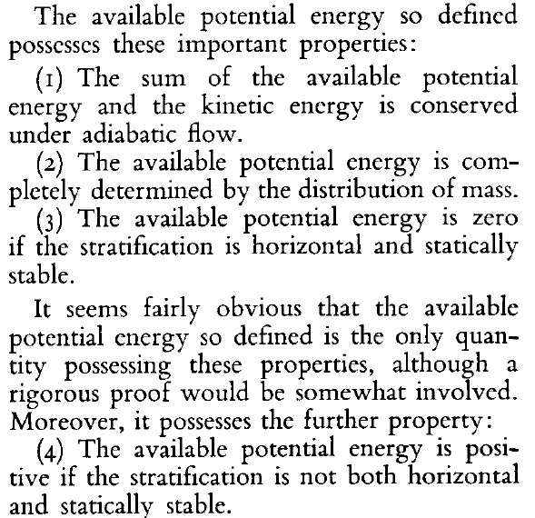
Lorenz Available Potential Energy

Slide 5
The Flattened Background State (Winters et al. 1995 JFM)

Slide 6
Local Available Potential Energy Holliday & McIntyre (1981 JFM)
Physical interpretation:
APE_{V} = the work required to move a fluid parcel against gravity + buoyancy vertically through the flattened stratification from its initial depth to its current depth.

Slide 7
Different Versions of PE and APE
The classic version assumes a “rest state” where all water parcels are at z = 0, and that to move to their actual location we do work as if moving them against gravity with ZERO buoyancy force (!!)

Slide 8
Volume Integrals
One can prove that the two ideas give the same result:

Slide 9
History
Lorenz (1955 Tellus) defined the concept of APE
Yih (1965) through Gill (1982) used the linearized form of APE_{V}
Holliday and McIntyre (1981 JFM) first derived the APE_{V} and conservation law, but notation was difficult
Shepherd (1993 Atm-Ocn) solved the whole problem and improved notation a bit
Winters et al. (1995 JFM) reminded the ocean community of how Lorenz’ concept could be used to diagnose volume-integrated mixing
Scotti et al. (2006 JFM) Rediscovered HM81 and applied it to internal waves
Kang & Fringer (2010) Improve notation and compare APE_{V} to other formulations
Scotti & White (2014 JFM) Apply APE_{V} to mixing in turbulent flows
Zemskova et al. (2015 JPO) Apply APE_{V} to ECCO2 general ocean circulation

Slide 10
Kinetic Energy Equation
Take dot-product of ρ₀u with x-mom (incompressible):
where we define a pressure anomaly:

Slide 11
APE Equation
Calculate the flattened stratification at each moment and then form D(APE_{V})/Dt:

Slide 12
Combined
Add them together and the “Conversion” term cancels...

Slide 13
Forming closed budgets in ROMS
Use the ROMS “diagnostics” for all terms in the momentum, temperature and salinity budgets in each grid box, averaged over an hour
Budget closes exactly by construction
Can do the same for the depth-averaged (“shallow water”) budgets
Results must be combined into the broad categories of the energy budget, e.g. all advection terms and pressure work go into a single box

Slide 14
What can we learn?
Take vertical integrals to reduce dimension while retaining spatial information
Form tidal averages of all terms
Take volume integrals over specific regions
BUT...often volume-integrated budgets, especially in the estuary, are dominated by tides (external pressure work = dissipation) making it hard to learn anything
One fix is to subtract the SW energy budget from the full budget: E’ = E – E^{SW}
Another way is just to consider the APE budget. The advection term gives the rate of loss of APE to conversion and exchange through the mouth (estuary case)

Slide 15
Energy Budget Terms vertically integrated & tidally averaged

Slide 16
APE (2 kinds) & KE vertically integrated & tidally averaged

Slide 17
Shelf Volume Integrals
Wind “fills” APE on shelf in late Spring, but what causes slow decay in Fall?

Slide 18
Estuary Volume Integrals
Advection + Conversion would “drain” APE in 11 months
Notes:
The average Advection for APE’ rate is -3e7 W, and the average APE’ reservoir is 8.7e14 J. The ratio of the reservoir to the rate gives a “draining” timescale of 11 months.
The means of the other terms are Mixing = 1e7W, dAPE/dt = -1e7, Background = 1e7, so none can be neglected! At least the mixing is consistently positive. One inconsistency is that in the plot is looks like the mean APE rate should be positive because it ends higher than it began.

Slide 19
Conclusions
The Local APE_{V} provides a useful tool for understanding coastal and estuarine (and other!) fluid systems
Vertically integrated maps & Regional volume integrals reveal separate reservoirs (“up & down APE”) and potentially allow quantified understanding
But, interpreting budget terms is difficult

